Slide 1
AI for Hiring
Tag
Project Team:
1.Ishan Borker
2.Garima Jain

Slide 2
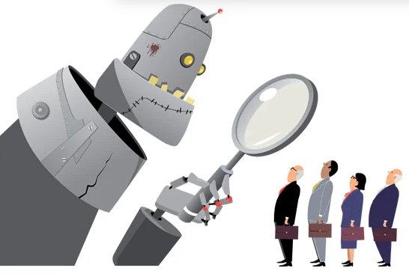
Use Case - Overview
Important step in recruitment to reduce time consuming activities like manually screening of the resumes
To design an Artificial Intelligence (AI) model to predict the placement process of various colleges
The proposed AI system can be implemented through machine learning models

Slide 3
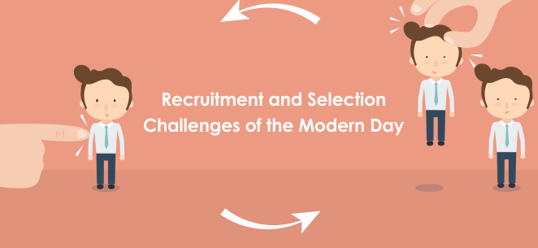
Problem
Manual screening of resumes by hiring team a tedious task
Filtering candidates to conduct various rounds of interviews
Give fair interview chance to each candidate

Slide 4
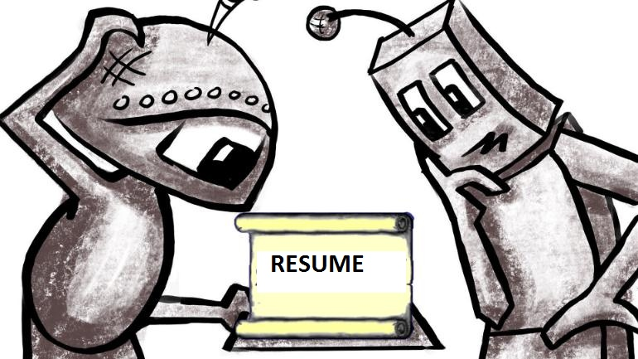
AI Proposition
Prescreen the resume of candidates based on the outcome of the model
Identifying eligibility of candidates based on marks, communication skills, logical reasoning
Check whether the candidate has been placed or not
Notes:
changes

Slide 5

Data Profile
Real time data was collected from students who have recently passed out
Few parameters used were marks, analytical, logical reasoning, position interviewed, CTC (Cost to Company)

Slide 6
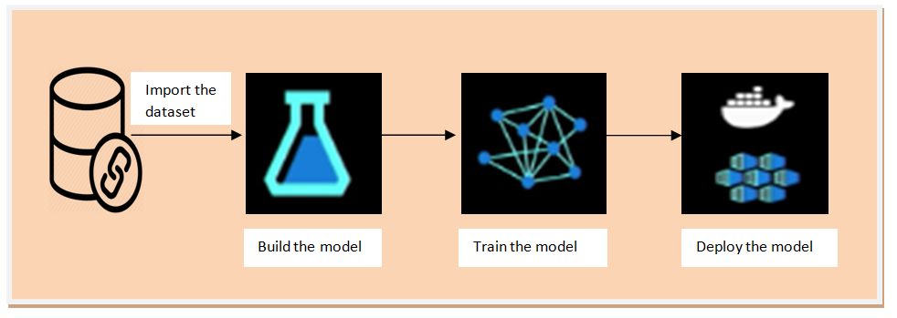
Architecture
Notes:
design

Slide 7
Technology - Code base
Loading the data using pandas
Python
Sklearn
Pandas
Matplotlib
Seaborn
Creating visualization using seaborn and matplotlib
Developing models using algorithms present in sklearn

Slide 8

Scalability and Implementation
Generate students placement reports
Create business insights based on the data
Predict the number of students placed based on the past data
Shortlist the students based on the marks and other criteria's
Notes:
changes

Slide 9

Business Value
University can use this for predicting the possibility of placement of the students
Hiring team will talk to the selected students based on the quality
Time saving activity for Hiring team
Can be implemented by the companies for tracking performance of the selected students

Slide 10

Scale up POC
Can add more features in the dataset in future
More data needs to be collected
Handle imbalanced datasets to make the predictions better
Encourage more colleges to use this model
Notes:
Discuss with Deepak regarding actual usability( use of app through keyword )

Slide 11
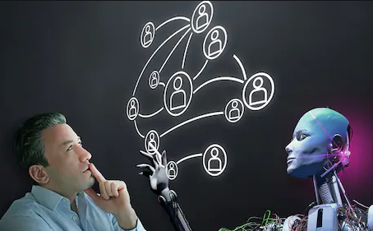
Further opportunities
Model can be used in training institutes
Can also be used companies where training is given to freshers

Slide 12
End Note
The “AI-Hiring”, will help to improve the student and industry relationship and overall the productivity of the placement process

Slide 13
References
https://www.intel.com/content/dam/www/public/us/en/documents/white-papers/ai-poc-whitepaper.pdf
https://www.irjet.net/archives/V6/i4/IRJET-V6I4997.pdf
https://www.aicte-india.org/sites/default/files/AICTE-CII-Survey-Report-2018_1.pdf
https://www.collegedekho.com/news/campus-placements-management-engineering-students-statistics-15132/
https://www.peoplestrong.com/india-skills-report-2019-47-engineering-graduates-employable-ap-leads-with-highest-employability-rate/

Slide 14
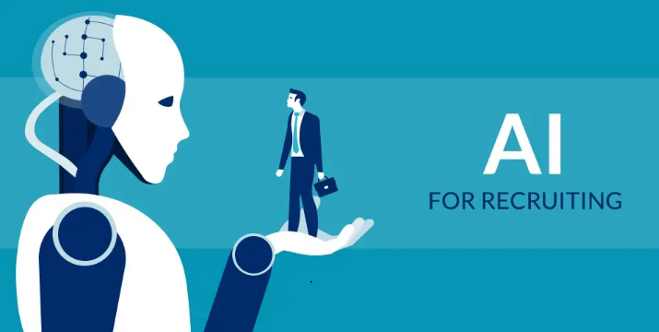
Thank you

